Slide 1
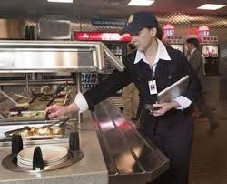

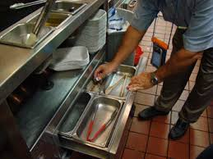
Restaurant Inspections:
Analysis of compliance and income correlation
Team:
Sam
Bashier
Chris
Josh
Eyob
Steve

Slide 2
Research Question & Data Sources
“Is there a correlation between restaurant inspection scores and income?”
Model City: Los Angeles
2017 Inspections: 29,282
Comparative City: San Francisco
2017 Inspections: 23,505
Data Sources
U.S. Open City Data Census
(http://us-city.census.okfn.org/dataset/food-safety)
U.S. Census Bureau / American Community Survey (ACS)
(https://www.census.gov/programs-surveys/acs)

Slide 3


Presentation
LA Story: Tableau Storyboard
Viols Wordcloud: Python / Matplotlib
LA/SF Modeling: Python / Matplotlib charts

Slide 4

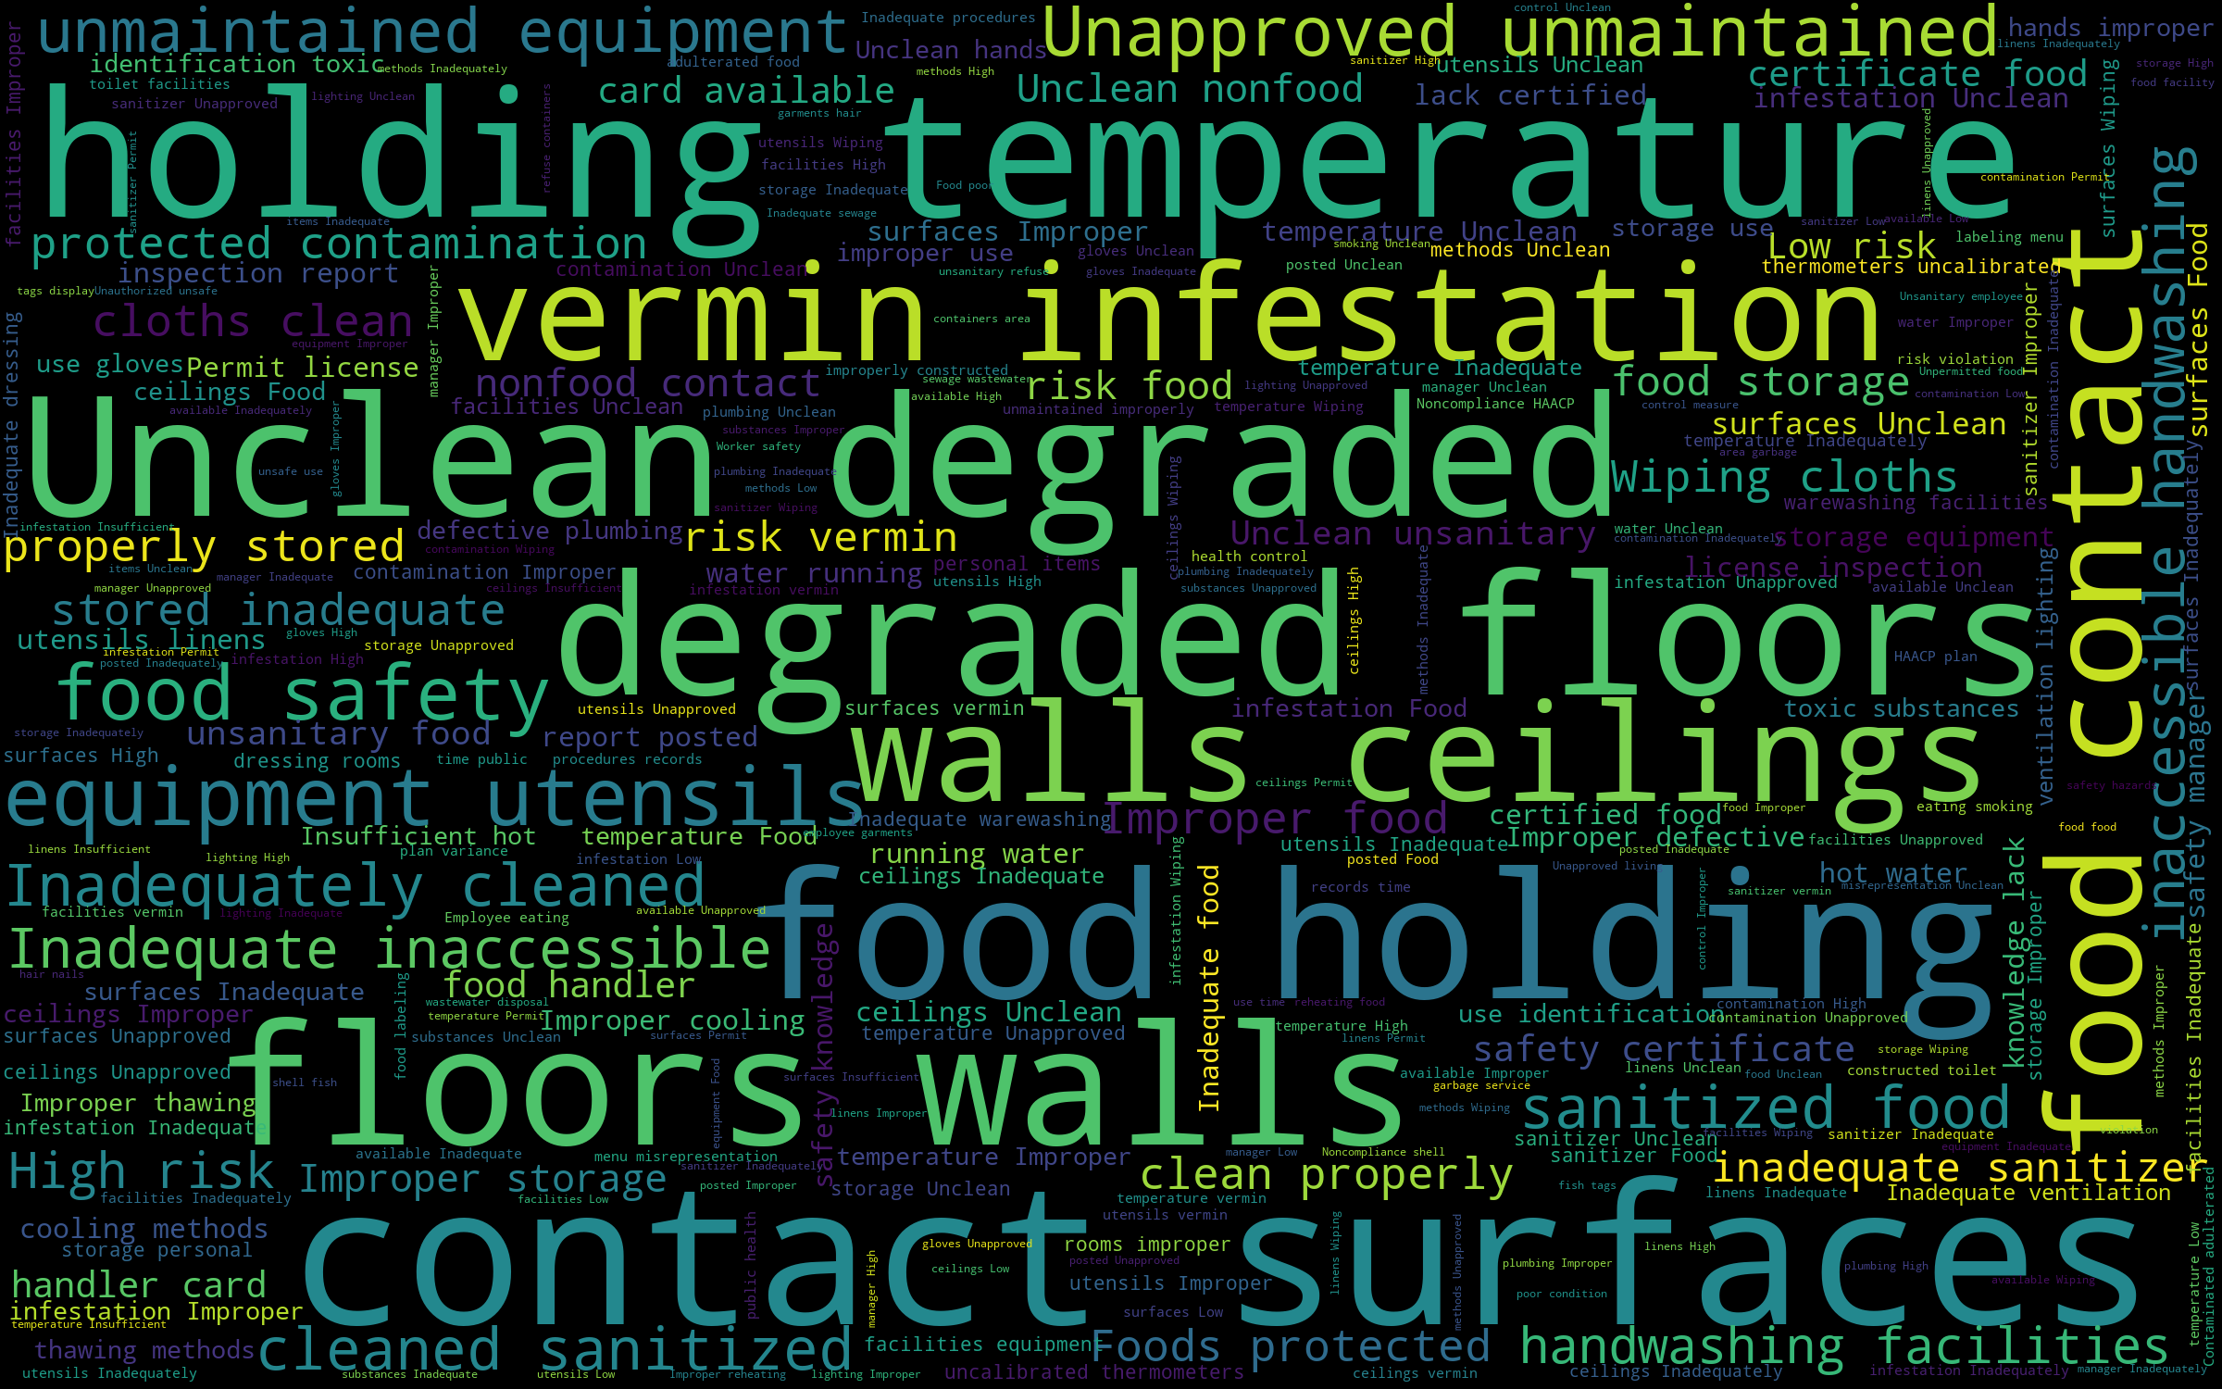
LA & SF Viols in a picture…
Los Angeles
San Francisco

Slide 5
Tableau

Slide 6
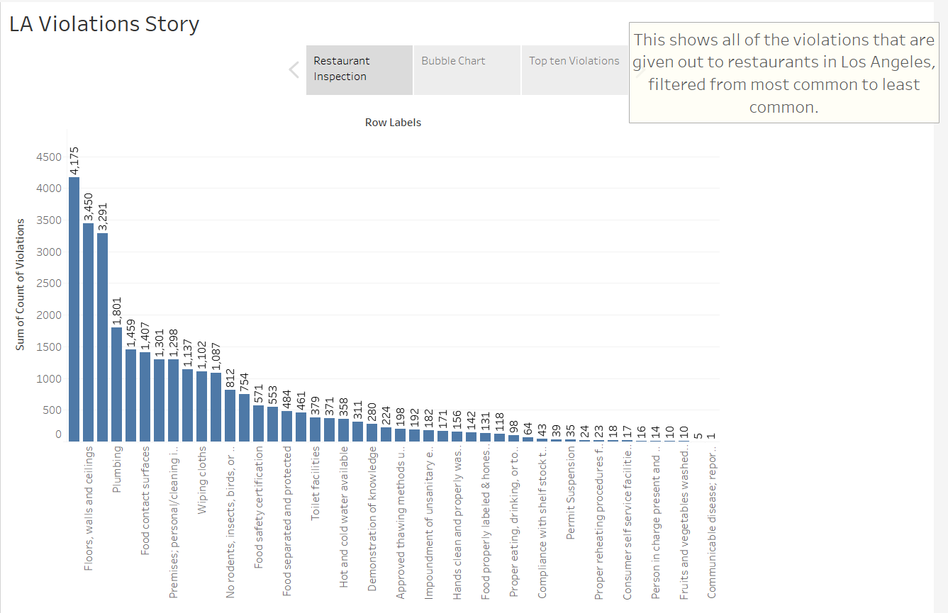


Slide 7


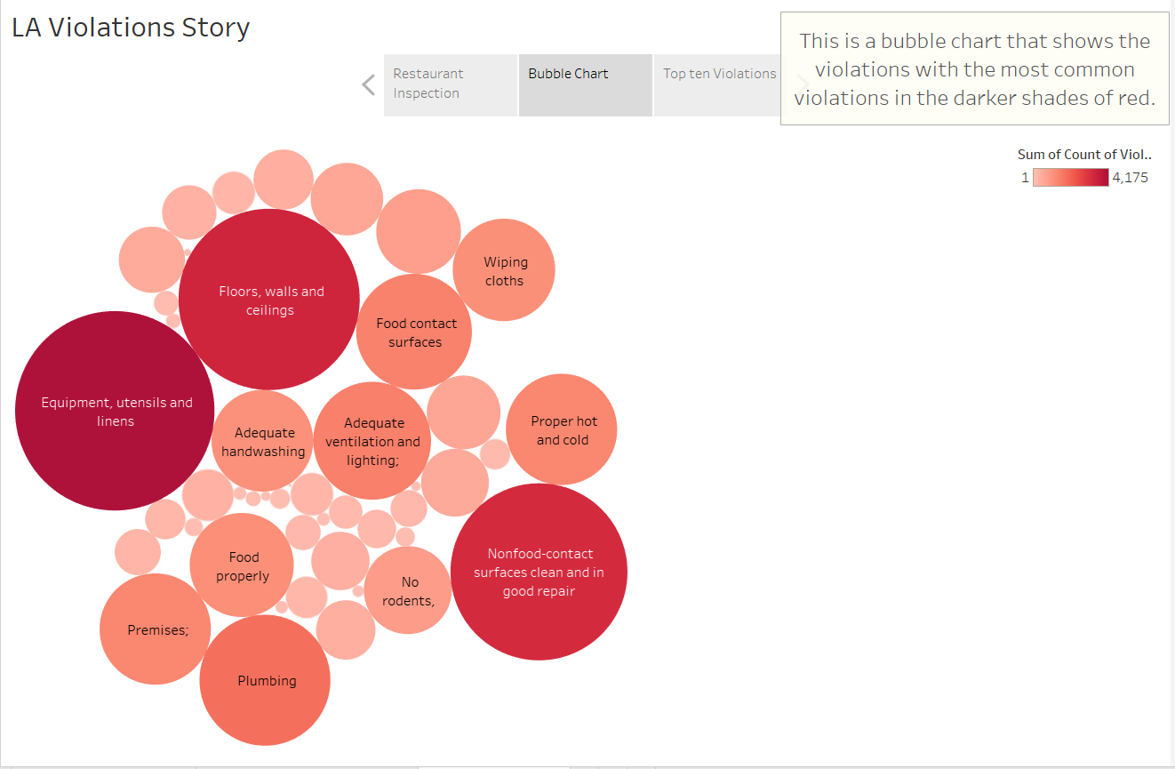




Slide 8
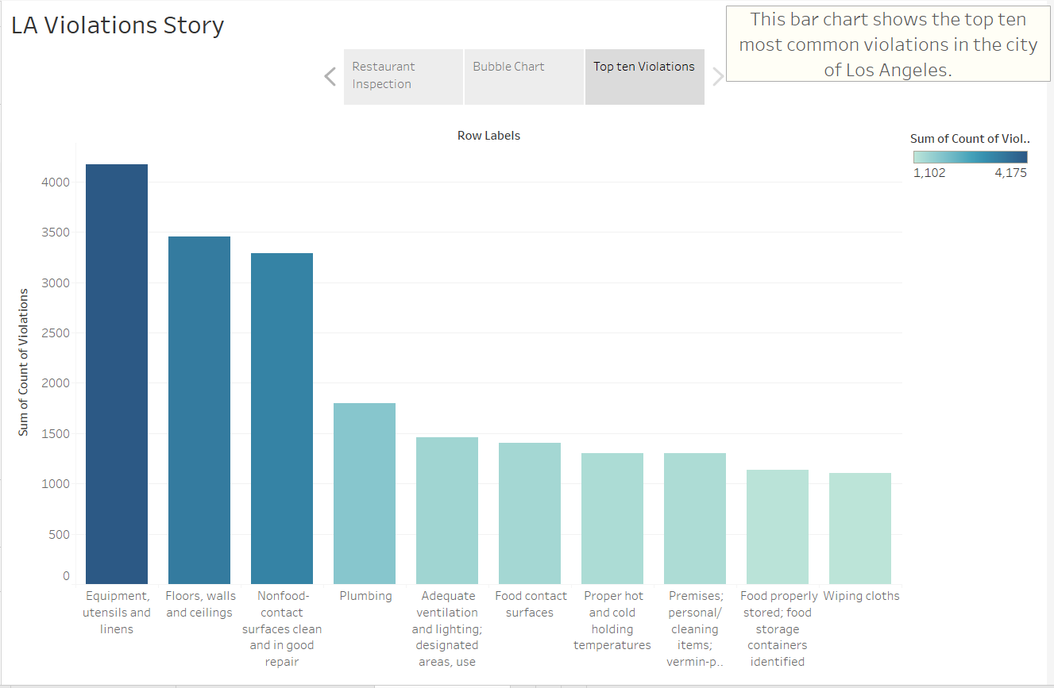

Slide 9
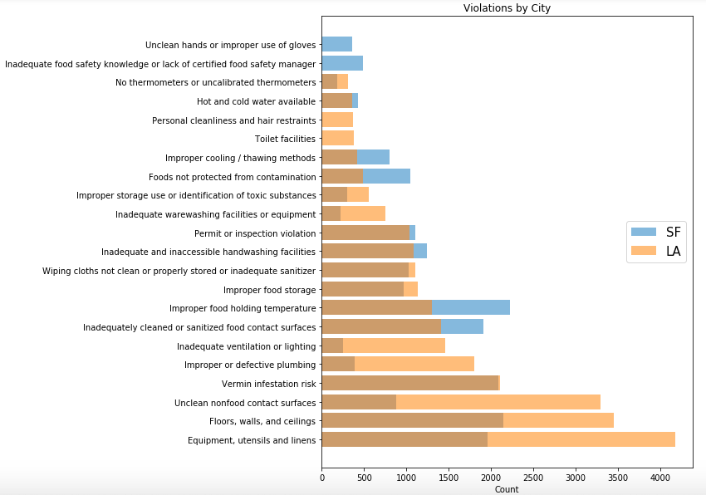

Slide 10
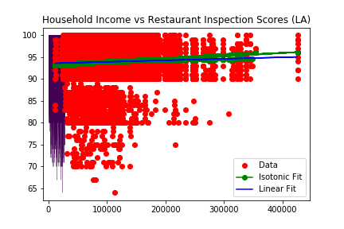
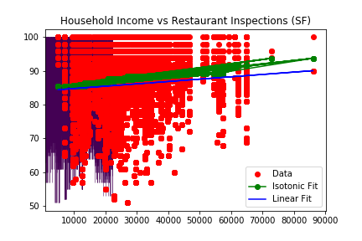

Slide 11
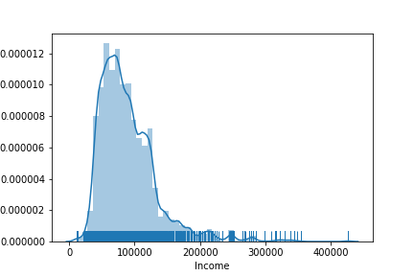
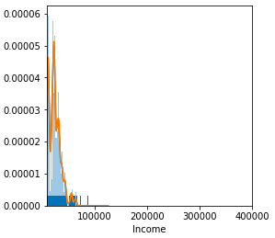
LA
SF

Slide 12
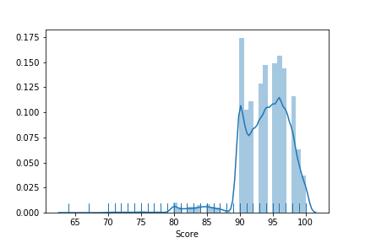
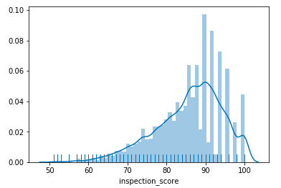
LA
SF

Slide 13
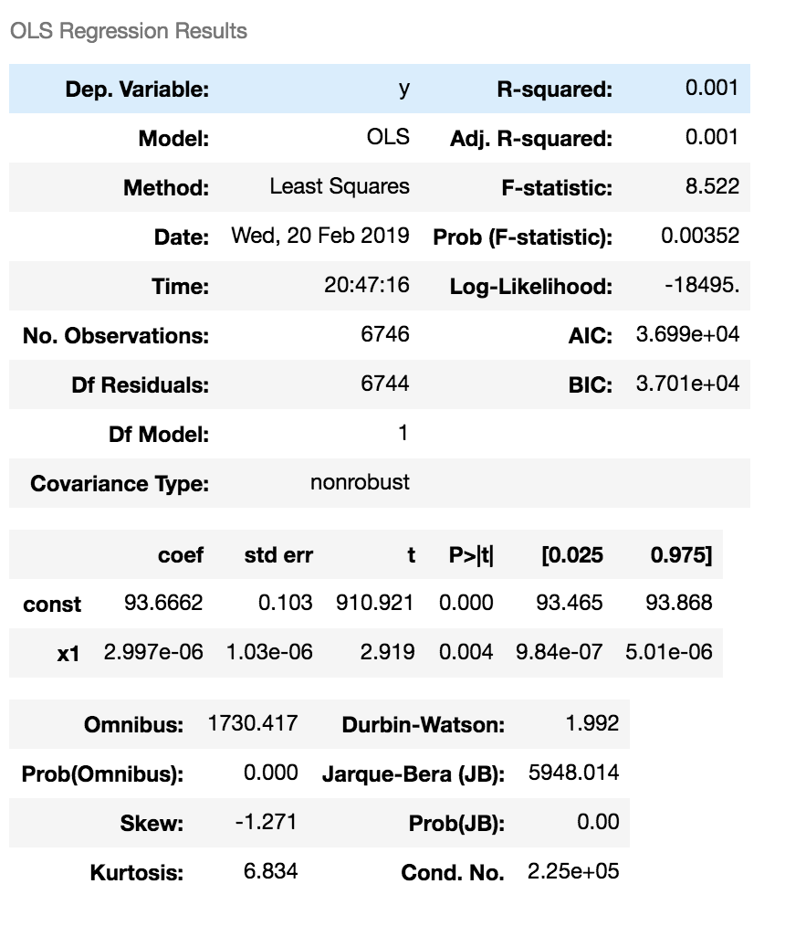
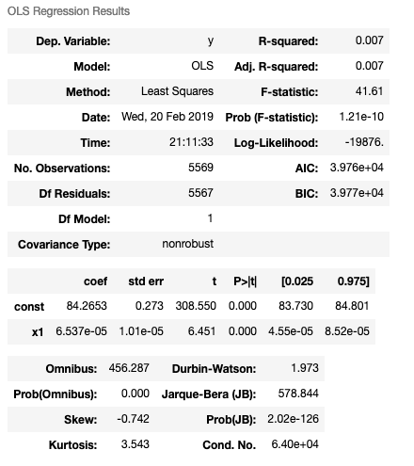
LA
SF

Slide 14
Resources Used for Analysis
Excel
Tableau
Python
Pandas
Matplotlib
Sci-Kit-Learn

